Slide 4


Slide 6
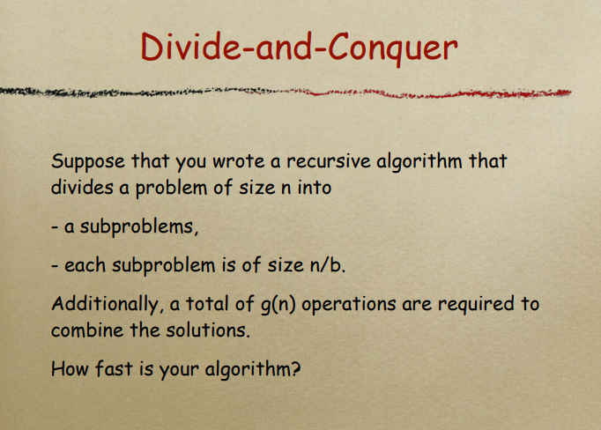

Slide 7
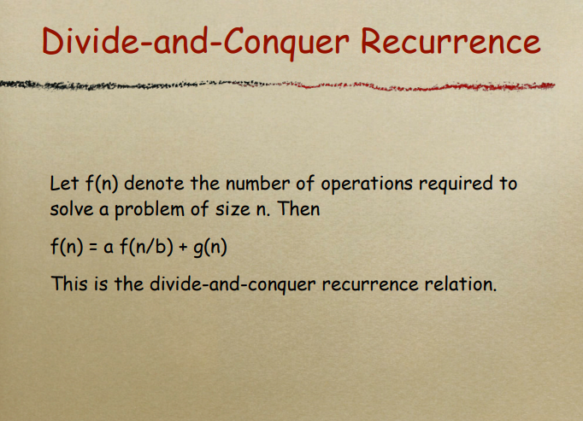

Slide 8
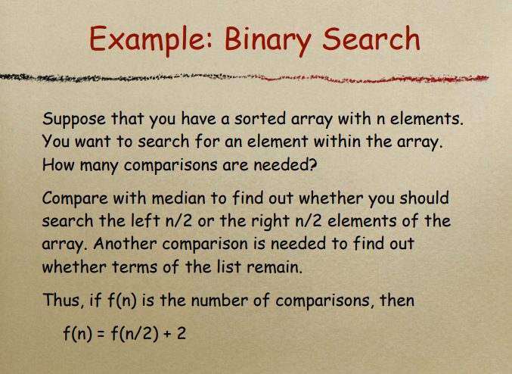

Slide 10
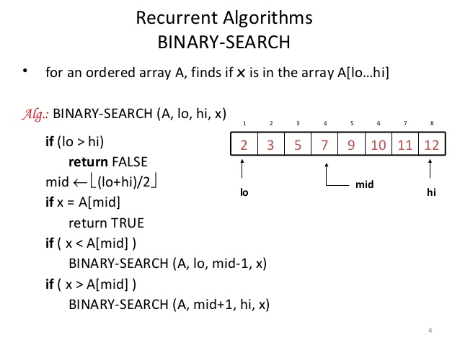

Slide 14
Animations
http://liveexample.pearsoncmg.com/liang/animation/animation.html

Slide 15
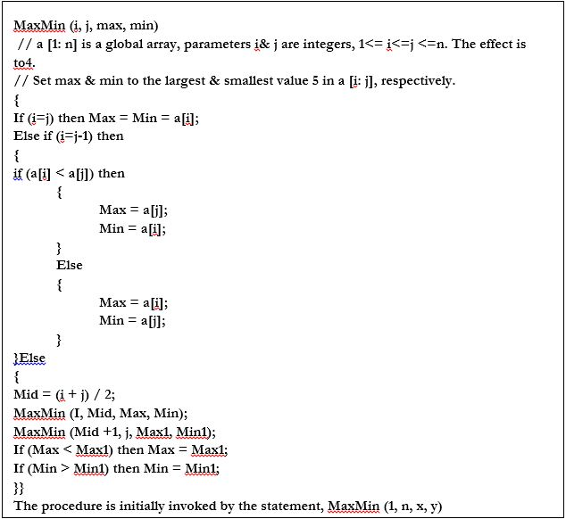

Slide 19
Merge Sort

Slide 20
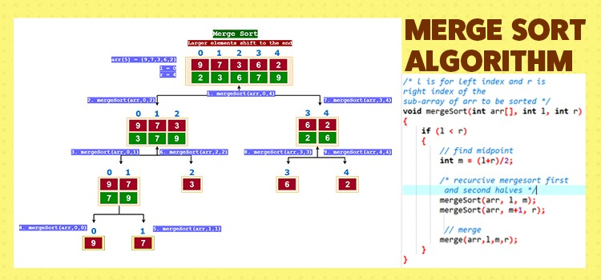
Merge Sort

